Slide 1
SharePoint Admin Agent:
Govern and manage your Tenant
End-to-End
Juan Carlos Gonzalez
Microsoft 365 & Microsoft 365 Copilot MVP
Notes:
SharePoint Admin Agent: Govern and manage your Tenant End-to-End

Slide 2









Juan Carlos González
Microsoft 365 & Microsoft 365 Copilot MVP | Microsoft 365 SME & Delivery Manager
@jcgm1978
jcgonzalezmartin1978@hotmail.com
https://nl.linkedin.com/in/juagon
https://www.youtube.com/@jcgonzalezmartin
https://jcgonzalezmartin.wordpress.com/

Slide 3
From PowerShell reports to governance decisions
Session promise
BEFORE
NOW
Hours of tenant reviews and custom PowerShell reports / Third party tools just to see where governance stood.
The agent runs the analysis. You focus on decisions, fast configuration changes and more control.
Built on SharePoint Advanced Management, the agent turns natural language into tenant-wide analysis and guided remediation, across active and inactive sites, storage, permissions and applied configuration.

Slide 4
Agenda
What we will cover
01
The governance problem
02
What the SharePoint Admin agent is
Why classic admin reporting in SharePoint stopped scaling
Copilot skills on top of SharePoint Advanced Management
03
Prerequisites & licensing
04
The admin skills, one by one
SAM, roles, and where to open the agent
Search, storage, lifecycle, permissions, Q&A
05
Demos
06
Key Ideas & Takeaways
Admin Agent availability, Tenant overview, oversharing, lifecycle cleanup
Benefits, limits, risks and more
Notes:
The governance problem: Why classic admin reporting in SharePoint stopped scaling
What the SharePoint Admin agent is: Copilot skills on top of SharePoint Advanced Management
Prerequisites & licensing: SAM, roles, and where to open the agent
The admin skills, one by one: Search, storage, lifecycle, permissions, Q&A
Demos: Tenant overview, oversharing, lifecycle cleanup
Key Ideas & Takeaways: Benefits, limits, risks and more

Slide 5
The governance problem
Many tenants accumulate sites faster than administrators can review them
Notes:
The governance problem: Why classic admin reporting in SharePoint stopped scaling
What the SharePoint Admin agent is: Copilot skills on top of SharePoint Advanced Management
Prerequisites & licensing: SAM, roles, and where to open the agent
The admin skills, one by one: Search, storage, lifecycle, permissions, Q&A
Demos: Tenant overview, oversharing, lifecycle cleanup
Key Ideas & Takeaways: Benefits, limits, risks and more

Slide 6
Where administrators used to spend their time
The old way
Manual reporting
Scattered audits
Stale on arrival
Hidden oversharing
No time to decide
Custom PowerShell reports for site inventory, activity, storage and more
Permission audits stitched together from several admin portals
Reports that took hours to run, and were stale on arrival
Ownerless sites and ‘Everyone except external users’ left undetected
Little time left for the actual governance decisions

Slide 7
What ungoverned content costs you
Why it matters now
Content sprawl
Oversharing
Ownerless sites
Copilot risks
Sites outlive the projects that created them and quietly consume storage.
Broad access groups expose content through Search, and now through Copilot.
Owners leave; nobody is accountable for permissions or lifecycle.
AI expands reach of whatever is already overshared.
Governance stopped being a reporting exercise, it became a prerequisite for safe AI adoption.

Slide 8
What the SharePoint Admin
agent is
An AI-powered governance experience for SharePoint Online and OneDrive for Business
Notes:
The governance problem: Why classic admin reporting in SharePoint stopped scaling
What the SharePoint Admin agent is: Copilot skills on top of SharePoint Advanced Management
Prerequisites & licensing: SAM, roles, and where to open the agent
The admin skills, one by one: Search, storage, lifecycle, permissions, Q&A
Demos: Tenant overview, oversharing, lifecycle cleanup
Key Ideas & Takeaways: Benefits, limits, risks and more

Slide 9

An AI governance assistant
Definition of the SharePoint Admin agent
The SharePoint Admin Agent helps administrators assess and remediate content-related risks across SharePoint and OneDrive for Business. Instead of running reports manually, you use natural language to investigate tenant-level conditions and take guided remediation actions.
Assessment → insights → remediation, in one conversational loop.

Slide 10

SharePoint Admin Agent & SAM
Reduce sprawl
Control oversharing
Manage lifecycle
SharePoint Admin Agent
Content Management Assessment
Inactive Site policy
Agent Insights
Catalog Management
Storage Management
Delegated Restricted Content Discovery
Site Lifecycle Policies
Site Attestation Policy
Customizable Email
Target policy on specific sites
Site Ownership Policy
Data Access Governance
Sites/files permissioned to “specific user”
Permission state report (Sites, ODBs, Files)
Everyone Except External Users insights
Site Access Review
Restricted Content Discovery (RCD)
Agents and Sites
AI Driven Semantic Site Matching
(Licensing TBD)
Recent Admin Actions
Restricted access control (RAC)
Sites, OneDrive
Change history
Block download policies
Sites, Files, Teams
Enterprise application insights
Extend SharePoint Permission
with Sensitivity labels
Copilot integration in SharePoint Admin Center + SAM
10

Slide 11

How the pieces fit together
SharePoint Admin Agent building blocks
You ask in natural language
Copilot app · SharePoint admin center · Microsoft Teams
SharePoint Admin Agent
Admin skills interpret the question and run the analysis
SharePoint Advanced Management
Governance signals & data: activity, storage, permissions, policies
SharePoint & OneDrive tenant
Sites, content, configuration and access
No PowerShell required, but the agent only sees what SAM is licensed and configured to collect.

Slide 12
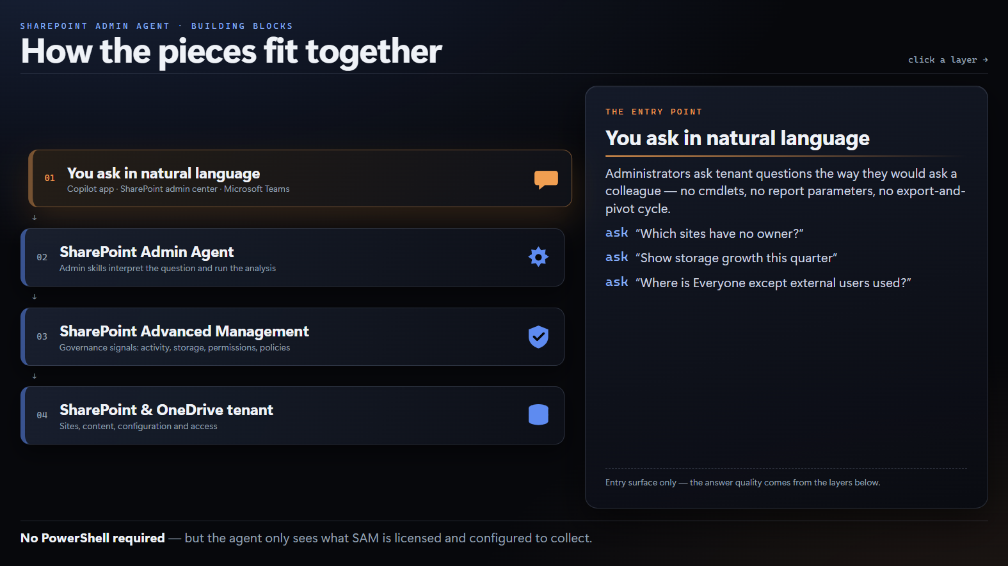

Slide 13


Demo #1: A first look to the SharePoint Admin Agent
Notes:
Accessing the SharePoint Admin Agent from Microsoft 365 Copilot

Slide 14
Prerequisites & licensing
SAM, roles, and where to “find” the agent
Notes:
The governance problem: Why classic admin reporting in SharePoint stopped scaling
What the SharePoint Admin agent is: Copilot skills on top of SharePoint Advanced Management
Prerequisites & licensing: SAM, roles, and where to open the agent
The admin skills, one by one: Search, storage, lifecycle, permissions, Q&A
Demos: Tenant overview, oversharing, lifecycle cleanup
Key Ideas & Takeaways: Benefits, limits, risks and more

Slide 15
Prerequisites and licensing
What you need before start with the SharePoint Admin Agent
Base subscription
SharePoint Advanced Management
Role and access
Office 365 E3, E5 or A5
Microsoft 365 E1, E3, E5 or A5
Business plans per Microsoft Learn
SAM is required for the agent
Included with Microsoft 365 Copilot
Otherwise, a paid add-on per user
SharePoint Advanced Management Administrator role in Microsoft Entra ID
Open from the Copilot app, SharePoint admin center or Teams

Slide 16
Demo #2: SharePoint Admin Agent prerequisites & Access options
Notes:
Prerequisites:
Licensing
Roles that can use the SharePoint Admin Agent
The other surface options

Slide 17
The admin skills, one by one
Six Copilot skills that cover discovery, storage, lifecycle and permissions.
Notes:
The governance problem: Why classic admin reporting in SharePoint stopped scaling
What the SharePoint Admin agent is: Copilot skills on top of SharePoint Advanced Management
Prerequisites & licensing: SAM, roles, and where to open the agent
The admin skills, one by one: Search, storage, lifecycle, permissions, Q&A
Demos: Tenant overview, oversharing, lifecycle cleanup
Key Ideas & Takeaways: Benefits, limits, risks and more

Slide 18
The skills at a glance
Skills Map
Contextual Q&A
Multi-variable site search
Admin centre recap
How-to and conceptual answers grounded in Microsoft Learn
Combine owner, activity, storage, sensitivity and sharing filters
Service health, message centre and Copilot usage in one summary
Storage
Lifecycle
Permissions
Consumption, outliers, growth trends and cleanup opportunities
Inactive sites, ownerless sites, archival and retention signals
Broad access groups, oversharing and policy inconsistencies
Copilot does not make configuration changes on your behalf; you stay in control of every action.

Slide 19
Prompt starter pack
Examples of prompts based on the available skills
"Show me how content is distributed across my tenant"
"Which sites are overshared and what are their risk levels?"
"Identify sites with low activity by department"
"Find inactive sites larger than 100 GB with external sharing enabled"
"Show me the top 10 agents accessing SharePoint and OneDrive content"
"What recovery options are available for my sites?"

Slide 20
Contextual Q&A and admin centre recap
Skills – Context
Contextual Q&A
Recap across the admin centre
Natural-language how-to and conceptual questions inside the admin centre
Answers grounded in Microsoft Learn documentation
Removes the round trip to external documentation
Still validate recommendations before tenant-wide changes
Service health advisories, incidents and planned maintenance
Message centre announcements and feature roadmap items
Microsoft 365 Copilot adoption and usage insights
One tenant status view instead of several portals

Slide 21
Demo #3: Contextual Q&A Recap across the Admin Center

Slide 22
Multi-variable site search
Skills – Discovery
Complex, multi-criteria sites queries across the tenant, expressed as a sentence instead of a script.
WHAT IT GIVES YOU
TRY ASKING
Combine site owner, last activity date, storage, sensitivity and sharing configuration
Natural language is translated into executable search conditions
Built for audits and for shortlisting cleanup or review candidates
"Find inactive sites larger than 100 GB with external sharing enabled"
"Show sites without an owner created from the Team site template"

Slide 23
Storage: understand and optimise consumption
Skill – Storage
Where your tenant storage actually goes, and what you can safely reclaim.
WHAT IT GIVES YOU
TRY ASKING
Total available storage plus the sites consuming a disproportionate share
Growth trends and anomalies, not just a point-in-time number
Cleanup opportunities: redundant and stale content
Guidance on storage limits and additional capacity
"Show me how content is distributed across my tenant"
"Which sites grew fastest in the last 90 days?"

Slide 24
Demo #4: Multi-variable site search + Storage skills

Slide 25
Lifecycle: active and inactive sites
Skill – Lifecycle
Site lifecycle management policies in SAM, surfaced conversationally.
WHAT IT GIVES YOU
TRY ASKING
Sites with no recent user activity, and sites with no assigned owner
Sites created from templates with different retention expectations
Feeds inactive sites, ownership and attestation policies
Policies notify and enforce, they never delete sites directly
"Identify sites with low activity by department"
"Which sites are candidates for archive this quarter?"

Slide 26
Permissions and oversharing
Skill – Permissions
The skill most teams adopt first, and the one with the clearest risk reduction.
WHAT IT GIVES YOU
TRY ASKING
Detects sites granting broad access groups such as 'Everyone except external users'
Finds inconsistencies between sharing policy and real access patterns
Reports risk levels and recommends remediation
Supports least-privilege reviews and access governance
"Which sites are overshared and what are their risk levels?"
"Show me the top 10 agents accessing SharePoint and OneDrive content"

Slide 27
Demo #5: Lifecycle + Permissions skills

Slide 28
Adopting it well
Benefits, honest limitations, and a 90-day plan.
Notes:
The governance problem: Why classic admin reporting in SharePoint stopped scaling
What the SharePoint Admin agent is: Copilot skills on top of SharePoint Advanced Management
Prerequisites & licensing: SAM, roles, and where to open the agent
The admin skills, one by one: Search, storage, lifecycle, permissions, Q&A
Demos: Tenant overview, oversharing, lifecycle cleanup
Key Ideas & Takeaways: Benefits, limits, risks and more

Slide 29
Benefits and limitations
An honest view
KEY BENEFITS
KEY LIMITATIONS
Faster governance insights
SAM licensing required
Natural-language analysis reduces manual reporting and investigation.
SharePoint Advanced Management is a prerequisite for use.
Reduced exposure risk
Privileged role required
Surfaces oversharing, excessive access and risky content conditions.
VS
Access is limited to the SAM Administrator role in Microsoft Entra ID.
Improved Copilot readiness
Human oversight remains
Helps make enterprise content more secure, relevant and governed.
Administrators must validate findings and approve remediation decisions.
Better lifecycle control
Focused workload scope
Supports ownership, attestation, inactive-site review and archiving.
The experience targets SharePoint and OneDrive content governance.
Greater admin efficiency
Not fully autonomous
Accelerates the path from tenant assessment to recommended action.
It identifies and guides, but governance processes still drive execution.
An AI governance assistant, powerful, but only as good as the governance model behind it.

Slide 30
Risks and implementation considerations
Plan for these
Risks
Considerations
Success metrics
Identified risk persists until remediation is done
Low governance maturity weakens recommendations
A false sense of readiness, not a substitute for a security programme
Establish governance ownership and escalation paths
Start with oversharing, inactive sites and Copilot readiness
Align findings with access reviews and retention
Oversharing remediation rate
Inactive sites archived
Reduction in excessive permissions
Time from detection to remediation
Use the agent inside recurring governance reviews, not as a one-off assessment.

Slide 31
Key takeaways
At least three things to remember
1
Governance became conversational
The analysis you used to script is now a question. Your time moves to decisions and configuration changes.
2
SAM is the foundation
The agent is only as capable as the SharePoint Advanced Management data and policies underneath it.
3
You are still the administrator
The agent finds, prioritises and recommends. Approving and acting remains a human responsibility.

Slide 32
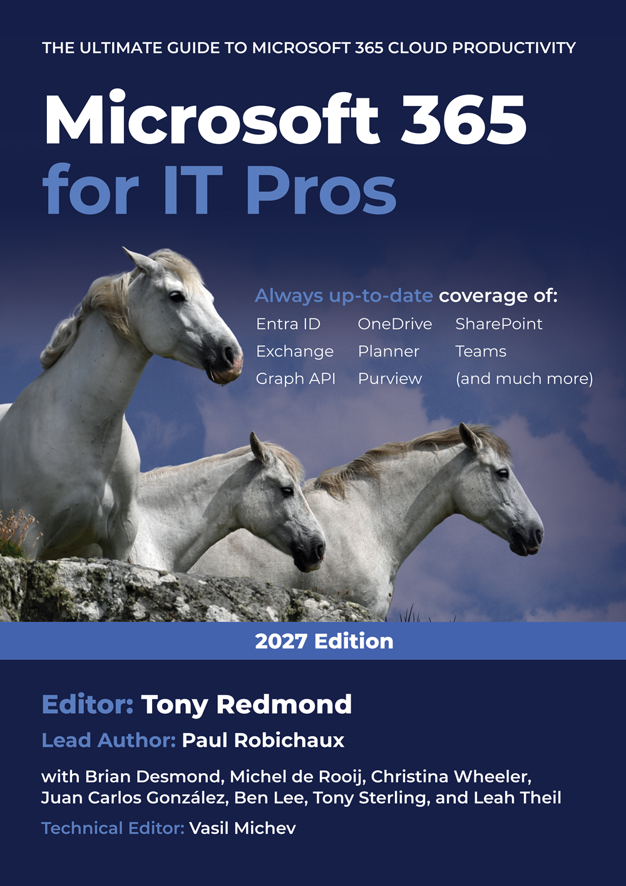
Microsoft 365 for IT Pros
The best way to stay up to date with Microsoft 365
Microsoft 365 for IT Pros (2027 Edition). The Ultimate Guide to Managing Microsoft 365.

Slide 33
Rate my session & Calls to Action
https://copilotbuzz.com/feedback

